Slide 1

Redhat Openshift

Slide 2
OpenShift – Application Scaling
Autoscaling is a feature in OpenShift where the applications deployed can scale and sink as and when required as per certain specifications. In OpenShift application, autoscaling is also known as pod autoscaling. There are two types of application scaling as follows.
Vertical Scaling
Vertical scaling is all about adding more and more power to a single machine which means adding more CPU and hard disk. The is an old method of OpenShift which is now not supported by OpenShift releases.
Horizontal Scaling
This type of scaling is useful when there is a need of handling more request by increasing the number of machines.
In OpenShift, thee are two methods to enable the scaling feature.
Using the deployment configuration file
While running the image

Slide 3

Using Deployment Configuration File
In this method, the scaling feature is enabled via a deployment configuration yaml file. For this, OC autoscale command is used with minimum and maximum number of replicas, which needs to run at any given point of time in the cluster.
Once we have the file in place, we need to save it with yaml format and run the following command for deployment.
One can also autoscale without the yaml file, by using the following oc autoscale command in oc command line.

Slide 4
Deployment Strategies in OpenShift
Deployment strategy in OpenShift defines a flow of deployment with different available methods. In OpenShift, following are the important types of deployment strategies.
Rolling strategy
Rolling strategy is used for rolling updates or deployment. This process also supports life-cycle hooks, which are used for injecting code into any deployment process.
Recreate strategy
This deployment strategy has some of the basic features of rolling deployment strategy and it also supports life-cycle hook.

Slide 5
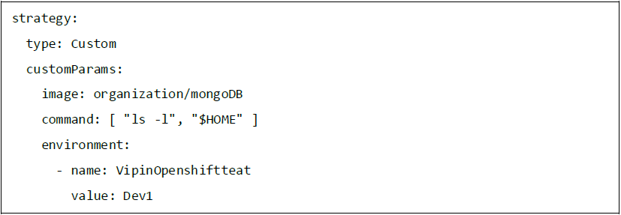
Custom Strategy
This is very helpful when one wishes to provide his own deployment process or flow. All the customizations can be done as per the requirement.

Slide 6
OpenShift – Administration
Master and Node Configuration
In OpenShift, we need to use the start command along with OC to boot up a new server. While launching a new master, we need to use the master along with the start command, whereas while starting the new node we need to use the node along with the start command. In order to do this, we need to create configuration files for the master as well as for the nodes.
For master configuration file
For node configuration file

Slide 7

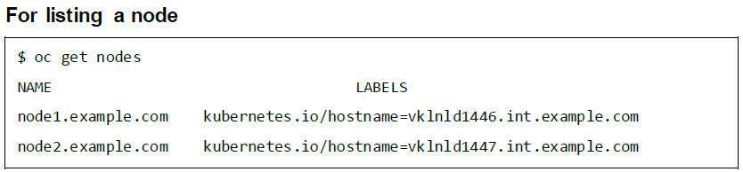
we can run the following command to create master and node server.
Managing Nodes
In OpenShift, we have OC command line utility which is mostly used for carrying out all the operations in OpenShift. We can use the following commands to manage the nodes.

Slide 8
Describing details about a node
Deleting a node
Listing pods on a node
Evaluating pods on a node

Slide 9
Configuration Authentication
In OpenShift master, there is a built-in OAuth server, which can be used for managing authentication. All OpenShift users get the token from this server, which helps them communicate to OpenShift API.
There are different kinds of authentication level in OpenShift, which can be configured along with the main configuration file.
Allow All - This will allow access to any user without entering any username and password.
Deny All - This will deny access to all usernames and passwords.
HTPasswd - HTPasswd is used to validate the username and password against an encrypted file password.
LDAP Identity Provider -This is used for LDAP authentication wherein LDAP server plays a key role in authentication.
Basic Authentication -This is used when the validation of username and password is done against a server-to-server authentication. The authentication is protected in the base URL and is presented in JSON format.

Slide 10
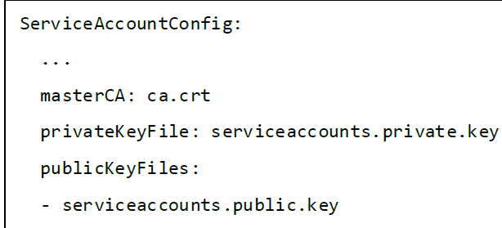
Configuring a Service Account
Service accounts provide a flexible way of accessing OpenShift API exposing the username and password for authentication.
Enabling a Service Account
Service account uses a key pair of public and private key for authentication.
Creating a Service Account
Use the following command to create a service account.

Slide 11
Working with HTTP Proxy
In most of the production environment, direct access to Internet is restricted. They are either not exposed to Internet or they are exposed via a HTTP or HTTPS proxy
This can be done by adding a proxy definition on the master and node files located under /etc/sysconfig. This is similar as we do for any other application.
Master Machine
/etc/sysconfig/openshift-master
Node Machine
/etc/sysconfig/openshift-node
For Docker Pull
/etc/sysconfig/docker

Slide 12
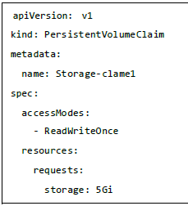

OpenShift Storage with NFS
In OpenShift, the concept of persistent volume and persistent volume claims forms persistent storage.
This is one of the key concepts in which first persistent volume is created and later that same volume is claimed.
Next, using OC create command create Persistent Volume.
Claiming the created volume.
Create the claim

Slide 13
User and Role Management
User and role administration is used to manage users, their access and controls on different projects.
Creating a User
Predefined templates can be used to create new users in OpenShift.
Use oc create –f <file name> to create users.
Use the following command to delete a user in OpenShift.
Limiting User Access
ResourceQuotas and LimitRanges are used for limiting user access levels. They are used for limiting the pods and containers on the cluster.
Describing the resource quote
Defining the container limits can be used for limiting the resources which are going to be used by deployed containers.
Limiting User Access
ResourceQuotas and LimitRanges are used for limiting user access levels. They are used for limiting the pods and containers on the cluster.

Slide 14
User project limitations
This is basically used for the number of projects a user can have at any point of time.
They are basically done by defining the user levels in categories of bronze, silver, and gold.
We need to first define an object which holds the value of how many projects a bronze, silver, and gold category can have.
Assigning a user to a particular level.
Adding roles to a user.
Adding a cluster role to a user.

Slide 15
Adding a cluster role to a group.
User for cluster administration
This is one of the most powerful roles where the user has the capability to manage a complete cluster starting from creation till deletion of a cluster.
User with ultimate power

Slide 16
OpenShift –Docker and Kubernetes
OpenShift is built on top of Docker and Kubernetes.. The main function of Kubernetes is to control OpenShift cluster and deployment flow using a different kind of configuration file. As in Kubernetes, we use kubctl in the same way we use OC command line utility to build and deploy containers on cluster nodes.
different kinds of config files used for creation of different kind of objects in the cluster.
Images
POD
Service
Replication Controller
Replica set
Deployment

Slide 17
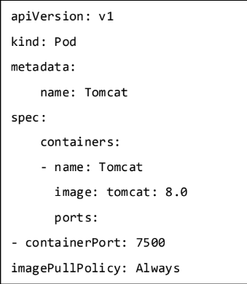
Images
Kubernetes (Docker) images are the key building blocks of Containerized Infrastructure. As of now, Kubernetes only support Docker images.
Each container in a pod has its Docker image running inside it.
POD
A pod is collection of containers and its storage inside a node of a Kubernetes cluster. It is possible to create a pod with multiple containers inside it. Following is an example of keeping a database container and web interface container in the same pod.

Slide 18
Service
A service can be defined as a logical set of pods. It can be defined as an abstraction on top of the pod that provides a single IP address and DNS name by which pods can be accessed.
With Service, it is very easy to manage load balancing configuration. It helps PODs to scale very easily.
Replication Controller
Replication Controller is one of the key features of Kubernetes, which is responsible for managing the pod lifecycle.
It is responsible for making sure that specified numbers of pod replicas are running at any point of time.
Replica Set
The replica set ensures how many replica of pod should be running.
It can be considered as a replacement of the replication controller.

Slide 19
Deployment
Deployments are upgraded and higher versions of the replication controller. They manage the deployment of replica sets, which is also an upgraded version of the replication Controller.
They have the capability to update the replica set and they are also capable of rolling back to the previous version.
All config files can be used to create their respective Kubernetes objects.
$ Kubectl create –f <file name>.yaml
Following commands can be used to know the details and description of the Kubernetes objects.
For POD
$ Kubectl get pod <pod name>
$ kubectl delete pod <pod name>
$ kubectl describe pod <pod name>

Slide 20
For Replication Controller
$ Kubectl get rc <rc name>
$ kubectl delete rc <rc name>
$ kubectl describe rc <rc name>
For Service
$ Kubectl get svc <svc name>
$ kubectl delete svc <svc name>
$ kubectl describe svc <svc name>

Slide 21
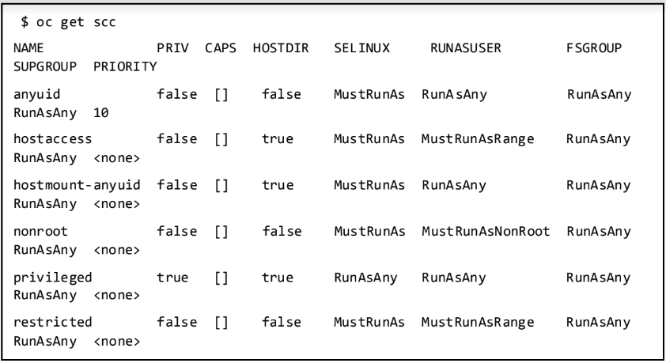
OpenShift – Security
Security Context Constraints (SCC)
Service Account
Security Context Constraints (SCC)
OpenShift provides a set of predefined SCC that can be used, modified, and extended by the administrator.

Slide 22
If one wishes to use any pre-defined scc, that can be done by simply adding the user or the group to the scc group.
$ oadm policy add-user-to-scc <scc_name> <user_name>
$ oadm policy add-group-to-scc <scc_name> <group_name>
Service Account
Service accounts are basically used to control access to OpenShift master API, which gets called when a command or a request is fired from any of the master or node machine.
$ oc create serviceaccount Cadmin
$ oc adm policy add-scc-to-user vipin -z Cadmin

Slide 23
Container Security
Image Provenance: A secure labeling system is in place that identifies exactly and incontrovertibly where the containers running in the production environment came from.
Security Scanning: An image scanner automatically checks all the images for known vulnerabilities.
Auditing: The production environment is regularly audited to ensure all containers are based on up-to-date containers, and both hosts and containers are securely configured.
Isolation and Least Privilege: Containers run with the minimum resources and privileges needed to function effectively. They are not able to unduly interfere with the host or other containers.
Runtime Threat Detection: A capability that detects active threats against containerized application in runtime and automatically responds to it.
Access Controls: Linux security modules, such as AppArmor or SELinux, are used to enforce access controls.

Slide 24
There are few key methods by which container security is archived.
Controlling access via oAuth
Via self-service web console
By Certificates of platform
Controlling Access via OAuth
In this method, authentication to API control access is archived getting a secured token for authentication via OAuth servers, which comes inbuilt in OpenShift master machine . As an administrator, you have the capability to modify the configuration of OAuth server configuration.
Via Self-Service Web Console
This web console security feature is inbuilt in OpenShift web console. This console ensures that all the teams working together do not have access to other environments without authentication. The multi-telnet master in OpenShift has the following security features -
TCL layer is enabled
Uses x.509 certificate for authentication
Secures the etcd configuration on the master machine

Slide 25
By Certificates of Platform
In this method, certificates for each host is configured during installation via Ansible.
During the initial setup of the master, custom certificates can be configured by overriding the existing certificates using openshift_master_overwrite_named_certificates parameter.
Example
openshift_master_named_certificates=[{"certfile":
"/path/on/host/to/master.crt", "keyfile": "/path/on/host/to/master.key",
"cafile": "/path/on/host/to/mastercert.crt"}]

Slide 26
Network Security
In OpenShift, Software Defined Networking (SDN) is used for communication.
Network namespace is used for each pod in the cluster, wherein each pod gets its own IP and a range of ports to get network traffic on it.
Isolating a Project
This can be done by the cluster admin using the following oadm command from CLI.
$ oadm pod-network isolate-projects <project name 1> <project name 2>
This means that the projects defined above cannot communicate with other projects in the cluster.

Slide 27
Volume Security
Volume security clearly means securing the PV and PVC of projects in OpenShift cluster.
There are mainly four sections to control access to volumes in OpenShift.
Supplemental Groups
fsGroup
runAsUser
seLinuxOptions
Supplemental Groups: Supplemental groups are regular Linux groups. When a process runs in the system, it runs with a user ID and group ID. These groups are used for controlling access to shared storage.
Check the NFS mount using the following command.
# showmount -e <nfs-server-ip-or-hostname>
Export list for f21-nfs.vm:
/opt/nfs *

Slide 28
fsGroup
fsGroup stands for the file system group which is used for adding container supplemental groups. Supplement group ID is used for shared storage and fsGroup is used for block storage.
runAsUser
runAsUser uses the user ID for communication. This is used in defining the container image in pod definition. A single ID user can be used in all containers, if required.
While running the container, the defined ID is matched with the owner ID on the export.
If the specified ID is defined outside, then it becomes global to all the containers in the pod. If it is defined with a specific pod, then it becomes specific to a single container.

Slide 29


